Slide 1
Secure data Hiding in Images using steganography
CAPSTONE PROJECT
Presented By
Student Name : Zia Ud Din Akbar
College Name & Department : University of People (B.Tech CS)

Slide 2
OUTLINE
Problem Statement
Technology used
Wow factor
End users
Result
Conclusion
Git-hub Link
Future scope

Slide 3
Problem Statement
In the modern digital era, ensuring secure communication presents a significant challenge. While encryption protects data by making it unreadable, it also highlights the presence of confidential exchanges. This project focuses on covert message transmission through steganography—the technique of concealing information within seemingly ordinary images. It introduces a user-friendly GUI application that seamlessly embeds text messages into digital images without noticeable changes, ensuring both security and discretion in communication.

Slide 4
Technology used
Libraries & Platforms
Libraries:
OpenCV (cv2)
Tkinter & ttk
NumPy
Pillow
OS
Pathlib
Platform:
Python 3.8+

Slide 5
Wow factors
Dark-Themed GUI – Modern, professional design with real-time updates and intuitive navigation.
Dual Input Support – Accepts text entry and file uploads with auto-validation.
Secure & Reliable – Password-protected encoding/decoding with error handling.
Smart Processing – Optimized pixel use ensures message integrity without overflow.

Slide 6
End users
Privacy-Focused Users
Educators & Students
Cybersecurity Experts
Digital Freedom Advocates

Slide 7
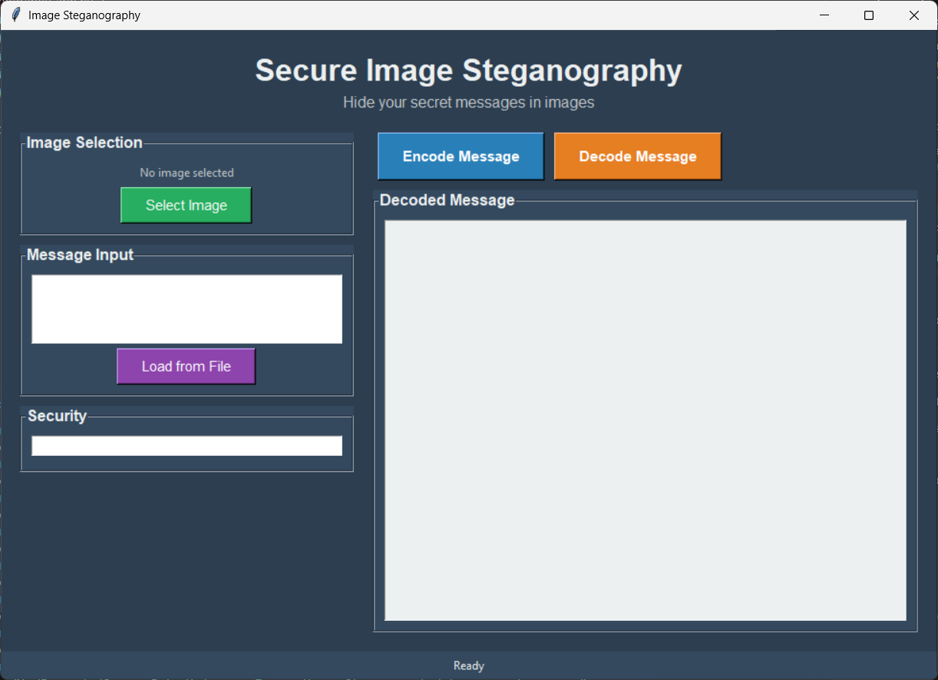
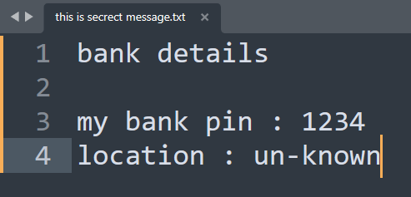
Results

Slide 8
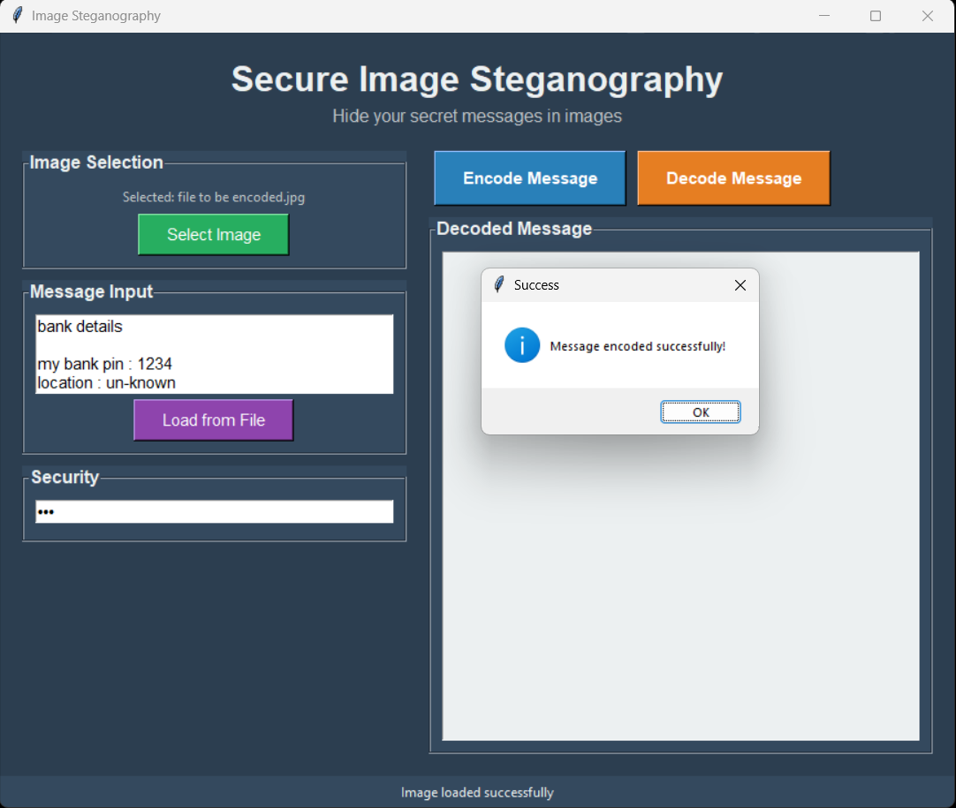
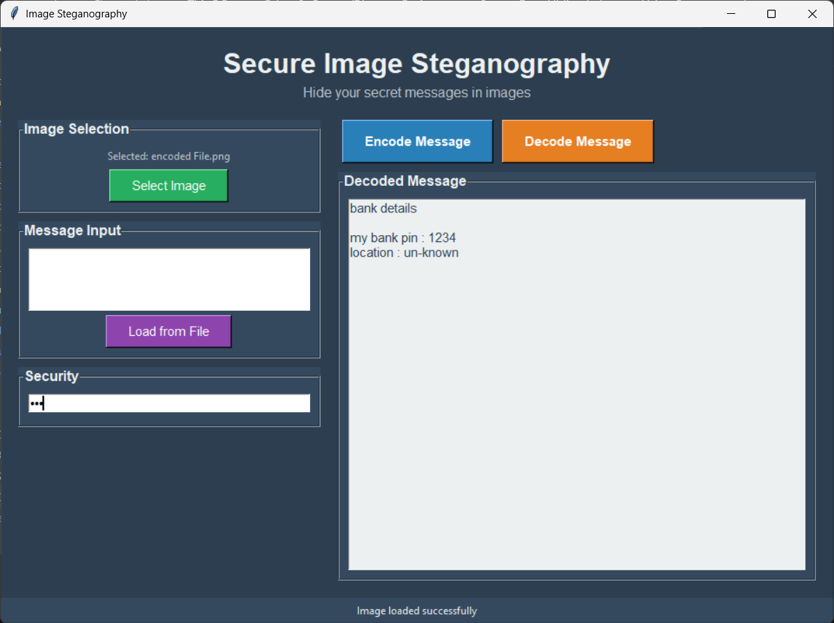
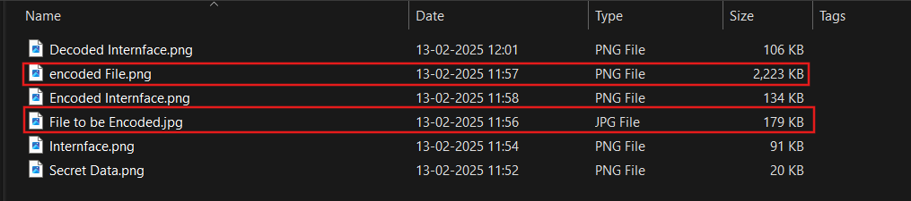
Results

Slide 9
Conclusion
This Image Steganography application provides a secure, user-friendly way to hide messages within digital images, effectively meeting the need for covert communication.
Security & Privacy – Implements LSB steganography with password protection, keeping messages hidden from casual observers.
Accessibility – Features an intuitive dark-themed GUI, making steganography easy for all users.
Reliability – Ensures message integrity with automatic capacity checks and efficient pixel use, preventing data loss.
The project balances security and usability, making private communication accessible to privacy-focused users, educators, and security professionals.

Slide 10
GitHub Link
https://github.com/Ziaulislambhatt/steganography

Slide 11
Future scope
Stronger Security – Combines AES/RSA encryption with steganography and supports embedding messages in audio and video files.
Cutting-Edge Features – Uses blockchain for message verification, enables secure cloud storage, and resists AI-based steganography detection.
Multi-Platform Compatibility – Develops mobile apps (Android/iOS) and a web-based version with real-time collaboration.

Slide 12
THANK YOU

